Slide 1
Gitlab Duo Usability as a BA

Slide 2
Gitlab Duo Usability as a BA
A GenAI‑powered BA accelerator that leverages GitLab Duo, structured prompts, and domain data to automate requirements analysis, routing logic, and functional design artifacts. It delivers consistent user stories, acceptance criteria, flow diagrams, and executive‑ready insights—reducing analysis effort while improving quality and speed
Base
Repo
Necessary inputs like requirement templates, routing rules, swift data.
Prompt
Config
Prompts to generate the functional assets
Playground
Safe environment to play around and perform validations
Design
Studio
Stores generated user stories, analysis, functional diagrams.
User Stories
Automated Creation of Acceptance Criteria's, user stories
Also summarizes assumptions, open points, out of scope items
Automated generation of routing analysis, gap analysis
Automated Functional Flow Diagram Generation
Enabled in Mermaid and PUML Languages
Professional stakeholder summary highlighting risks and gaps from the analysis
Perfect Data Statistics for business review
Requirement template
Routing Rules
Samples and Prompt
Swift Watch Data
Data Analysis
Gitlab Duo
Flow Diagrams
Stakeholder’s summary
Reduced analysis effort
Improved quality & consistency
Clear stakeholder communication
Better risk & gap visibility
Reusable Prompts & Templates
Consistent Standardized Outputs
Automated Functional Assets
Business
Benefits
Automation
Outcome

Slide 3
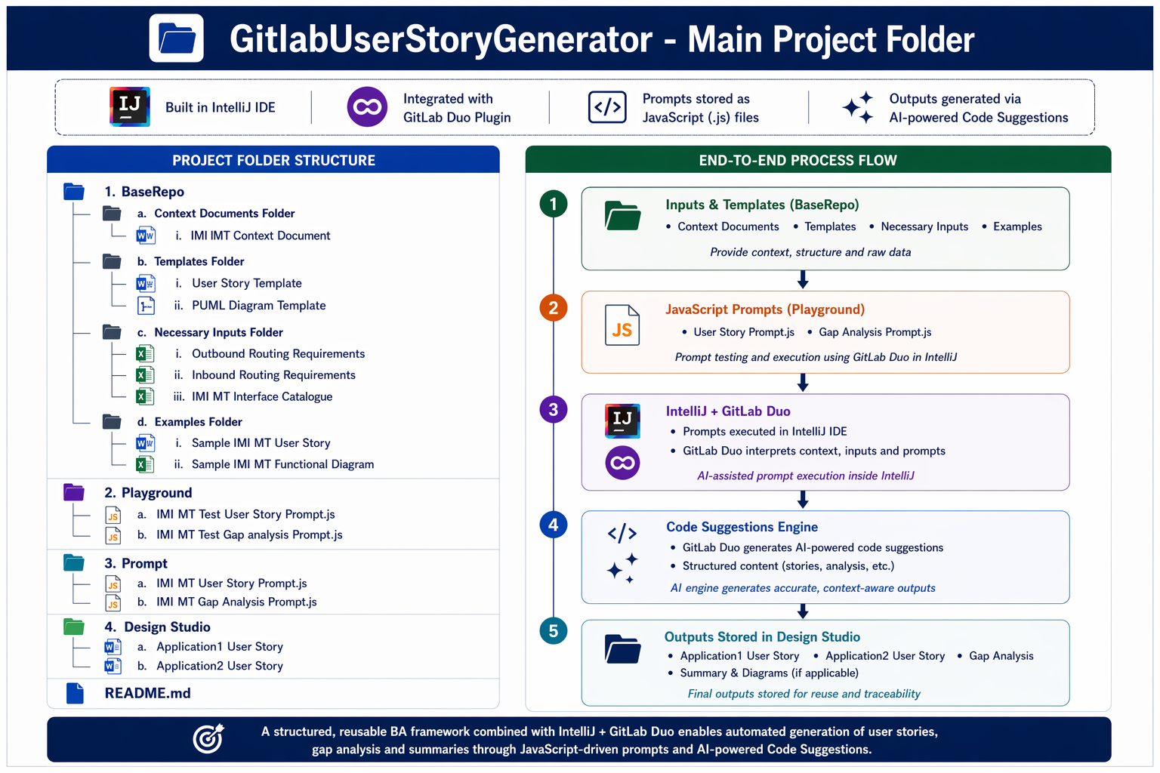

Slide 4
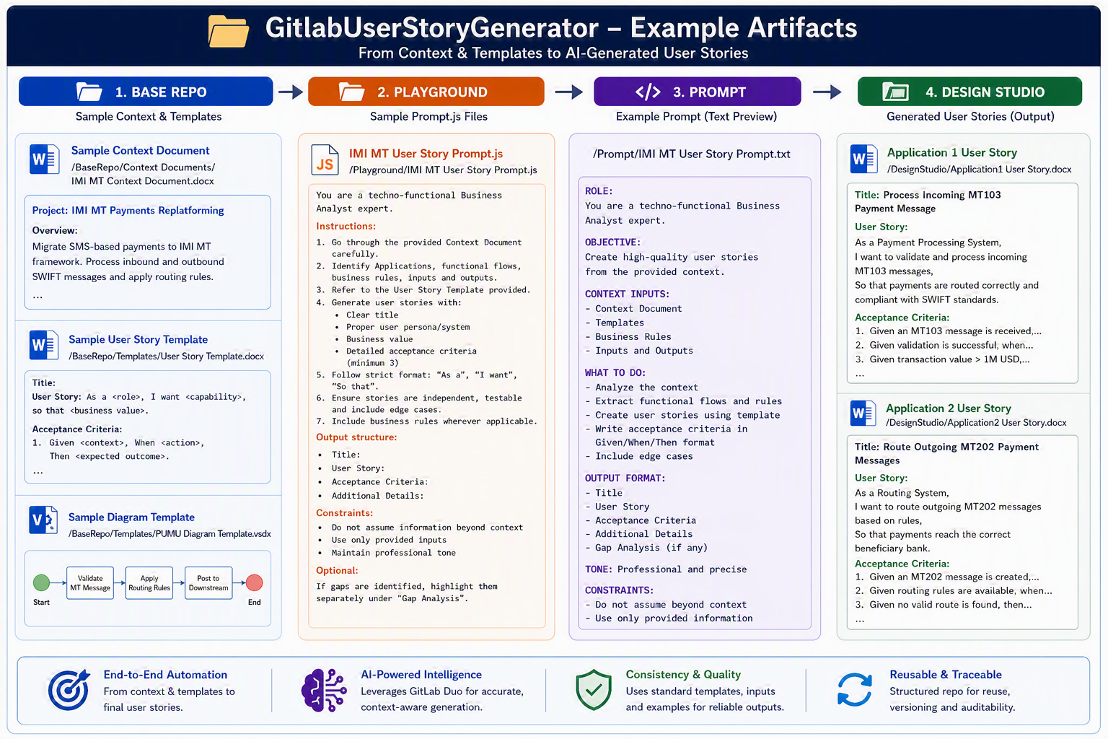

Slide 5
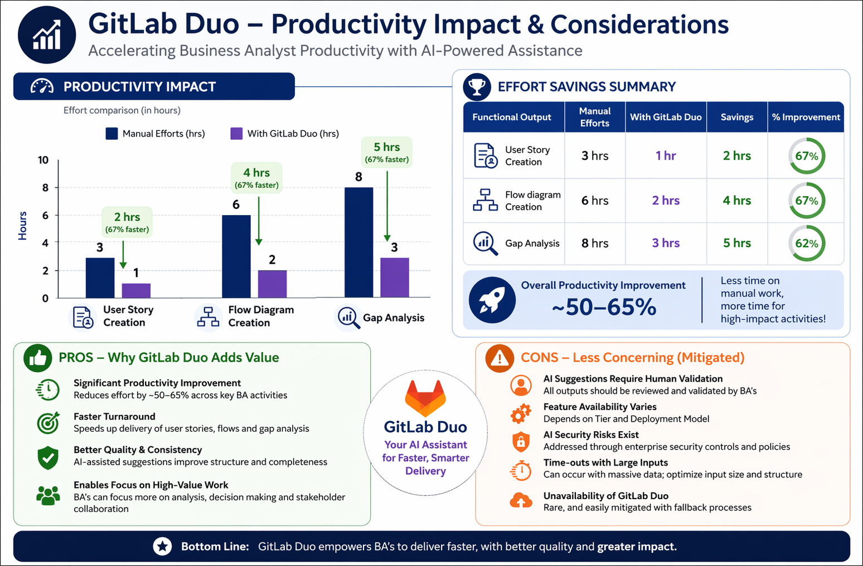

Slide 6
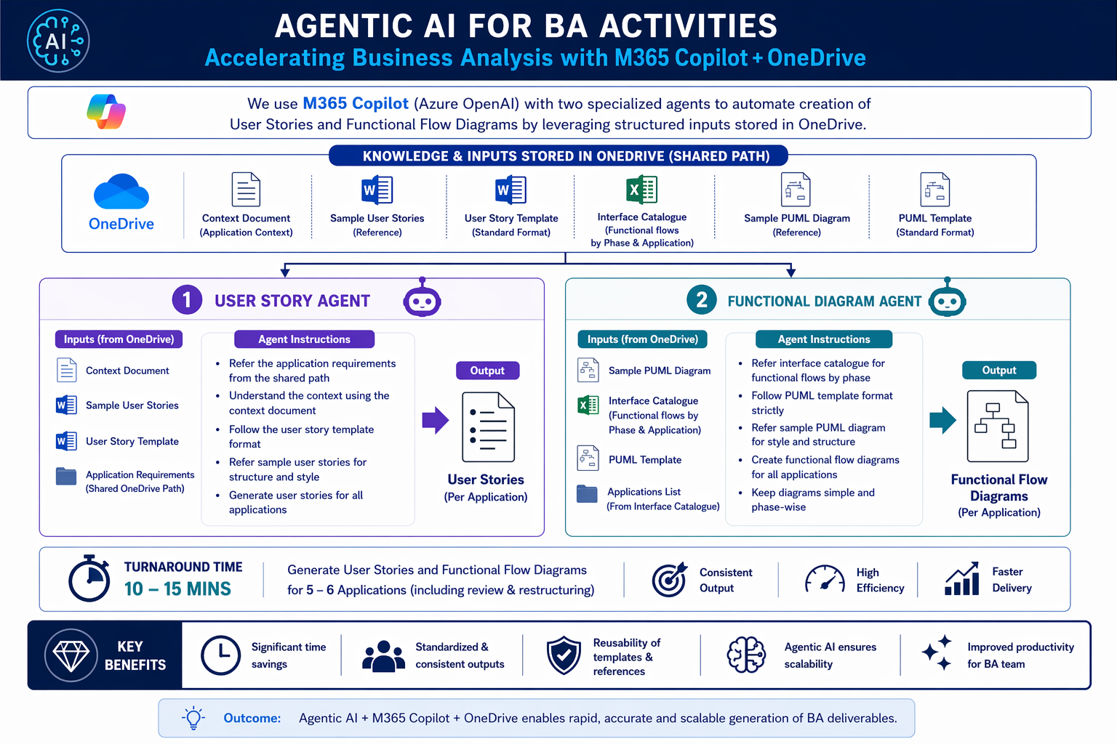

Slide 7
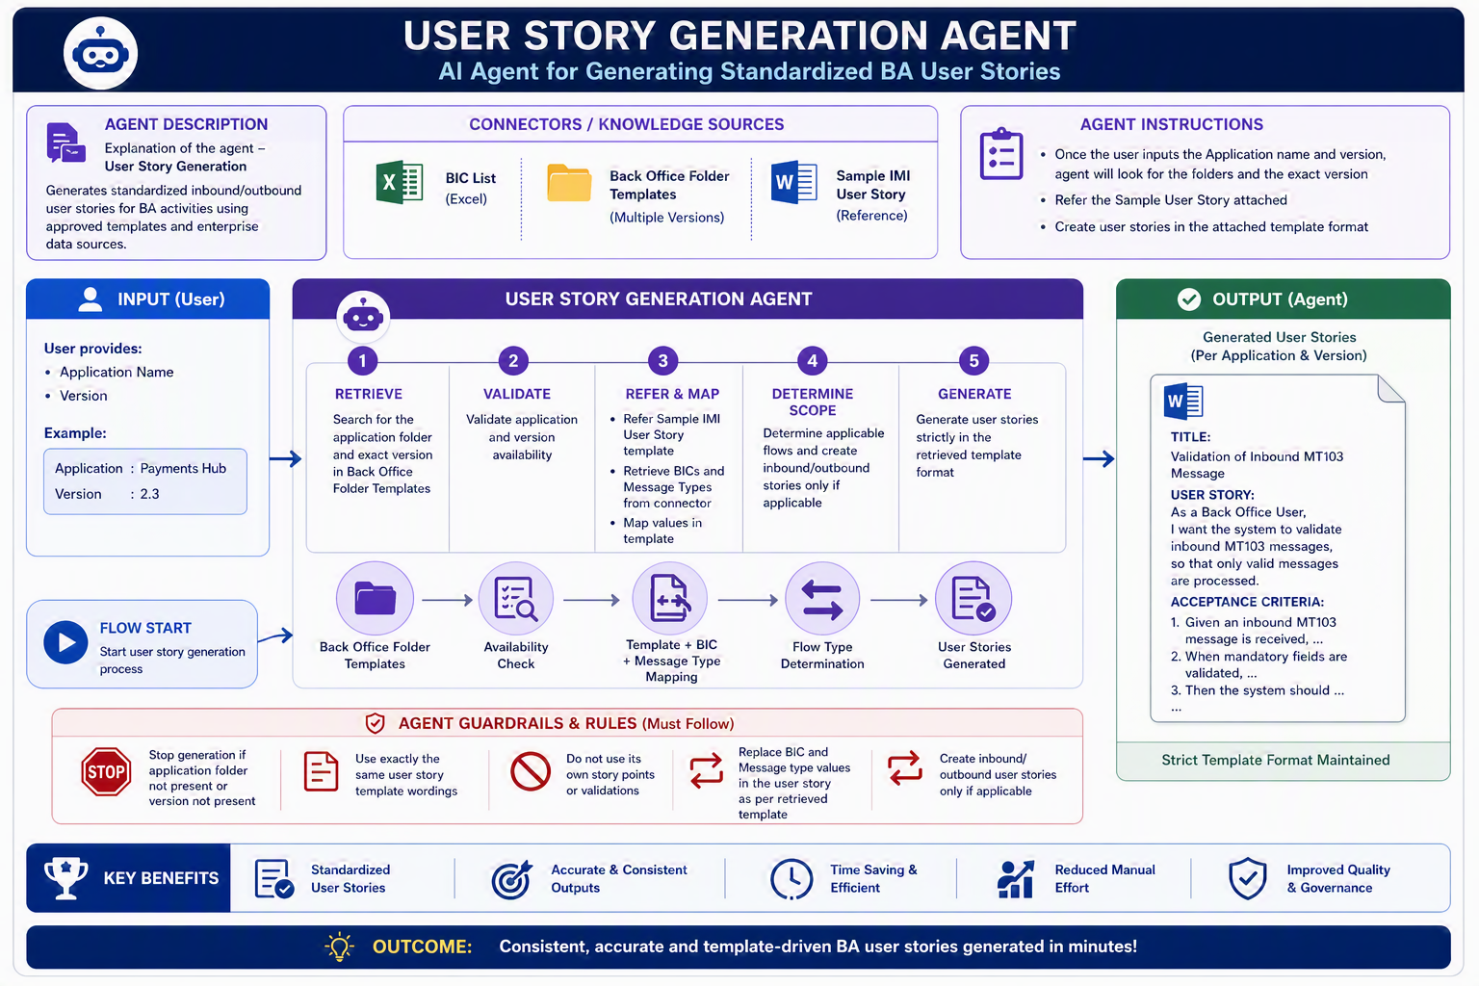

Slide 8
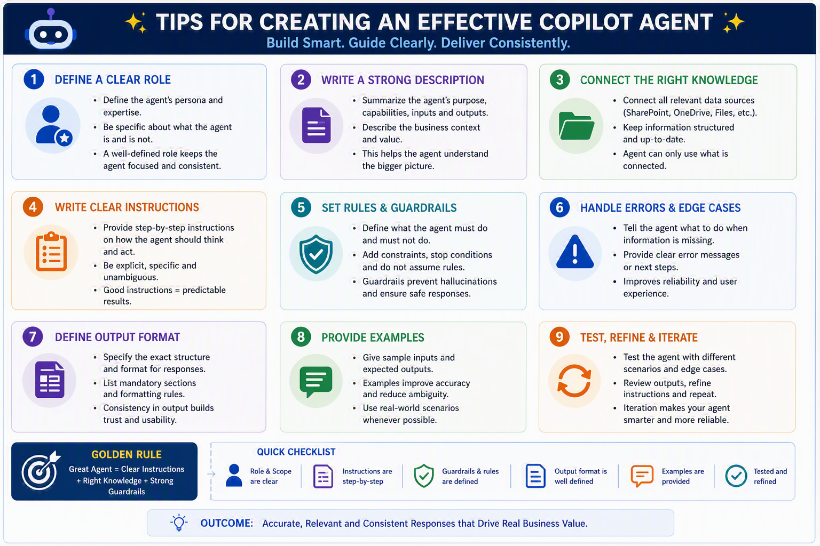

Slide 9
Brainstorming

